Slide 1

Linkedin Job Analysis
Linkedin Job Analysis
Team Members
Sumit Singh Rajpoot
Mayank Porwal
Amit BJ
Monu Kumar
Laraib Ahmed
Team Members
Sumit Singh Rajpoot
Mayank Porwal
Monu Kumar
Amit BJ
Laraib Ahmed

Slide 2

Objectives of Linkedin
Brand Awareness
Websites Visits
Engagement
Lead Generation
Job Seekers

Slide 3

Key Insights of Project
167/409 i.e. around 40% of jobs are having location BengaluruWebsites Visits
Top three companies with the highest job and with an employee count of more than 10001+ openings are
Ford Motors
Barclays
Citi

Slide 4
Top 10 companies according to their jobs posted on LinkedIn
Ford Motor Company
Barclays
Citi
Washup. co
Info parks Kerala
DBS Bank
Genpact
Infosys
EY
Imaginators Try Going Beyond

Slide 5
Top 5 Sectors Based on Followers.
IT Services and IT Consulting
Financial Services
Motor Vehicle Manufacturing
E-Learning Providers
Banking

Slide 6
Top 5 job Title(job_name)
Associate
Business Development Associate
Executive Assistant6
Virtual Assistant5
Team Member - Level 1

Slide 7

Top 5 job Locations Based on Job counts
Bengaluru
Chennai
Mumbai
Pune
Hyderabad

Slide 8


Slide 9
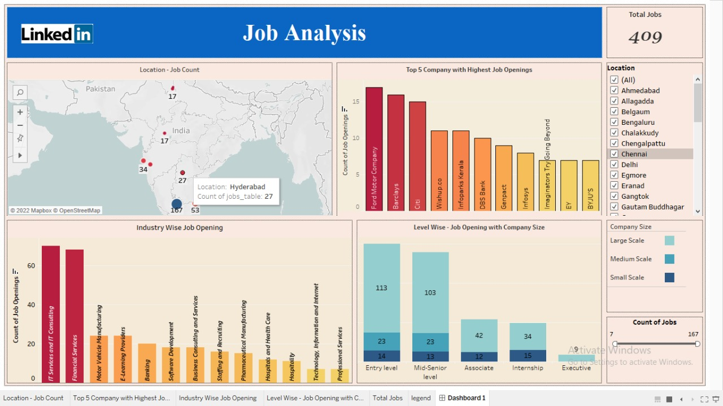
Dashboard

Slide 10
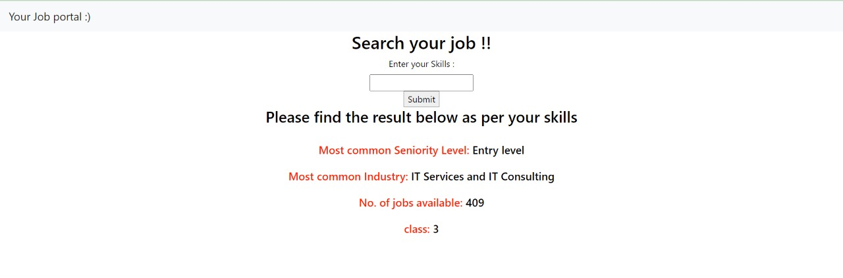
Web Page Interface

Slide 11
Learnings
WEB SCRAPING: Working knowledge of Python Packages like Selenium, Beautiful Soup Lib, and how to do web scraping.
01
Use Tableau for Data Visualization
And finding Key Insights
02
How to make Data models, and web pages & explore HTML, CSS, and Flask API For Deployment
03
Teamwork, Tackling more complex problems,
Time management
04

Slide 12
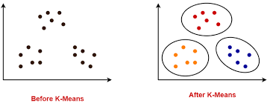
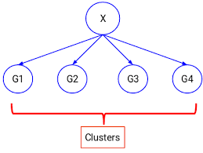
Kmeans Clustering
Based on the Count of Employees and Linkedin Followers we categorize the Column Class into Class1, Class2, Class3, Class4
CCOMPANY TABLE

Slide 13

Thank You

